Slide 1
Future of the IP: IPv6(IPng)
Volkan ESKİCİOĞLU

Slide 2

Success of IPv4
Supporting heterogeneity
Performance
Scalability

Slide 3
So why need change?
Growth
  Billions of new users
  Billions of new devices
New generation applications

Slide 4
Characteristics of IPv6
Address size
Header format
Extension headers
Support for audio and video
Extensible protocol

Slide 5
IPv4 & IPv6 headers
Ver.
Hdr
Len
Hdr
Len
Type of
Service
Total Length
Ver.
Traffic
Class
Flow Label
Identification
Flg
Fragment
Offset
Identification
Flg
Fragment
Offset
Payload Length
Next
Header
Hop
Limit
Time to
Live
Protocol
Header
Checksum
Header
Checksum
Source Address
Source Address
Destination Address
Options...
Padding
Options...
Padding
Destination Address

Slide 6
IPv6 Extension Headers
IP options have been moved to a set of optional Extension Headers
Extension Headers are chained together
IPv6 Header
TCP Header
Application Data
Next = TCP
IPv6 Header
Fragment Hdr
Security Hdr
TCP Header
Data
Frag
Next = Frag
Next = Security
Next = TCP

Slide 7
Purpose of Multiple Headers
Economics
  Less header space
Extensibility
  Adding new features
  New feature testing with the existing structure

Slide 8
Six Extension Headers
Hop-by-hop option header
Source routing header
Fragment header
Authentication header
Encryption header
Destination options

Slide 9
IPv6 Addressing Architecture -1
128 bit addressing
  2⁹⁶ times the size of IPv4 address space
  340,282,366,920,938,463,463,374,607,431,768,211,456
  665,570,793,348,866,943,898,599 addresses/m²
3 types
  Unicast
  Multicast
  Anycast

Slide 10
Basic Address Types
unicast:
for one-to-one
communication
multicast:
for one-to-many
communication
anycast:
for one-to-nearest
communication
U
M
M
M
A
A
A

Slide 11

IPv6 Addressing Architecture -2
Representation of addresses
  Hexadecimal form
    69DC:8864:FFFF:FFFF:0:1280:8C0A:FFFF
  Zero compression
    FF0C:0:0:0:0:0:0:B1 becomes FF0C::B1
  IPv4 embedded
    0:0:0:0:0:0:10.0.101.7

Slide 12
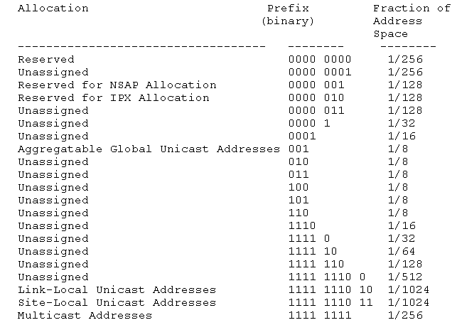
Allocation of Prefixes

Slide 13
IPng Routing
IPv4 routing algorithms can be used
Routing extensions
  Provider selection
  Host mobility
  Auto-readdressing

Slide 14
What is 6bone?
The 6bone is an IPv6 Testbed that is an outgrowth of the IETF IPng project that created the IPv6 protocol
The 6bone is currently a world wide informal collaborative project
The initial 6bone focus was on testing of standards and implementations, while the current focus is more on testing of transition and operational procedures.

Slide 15
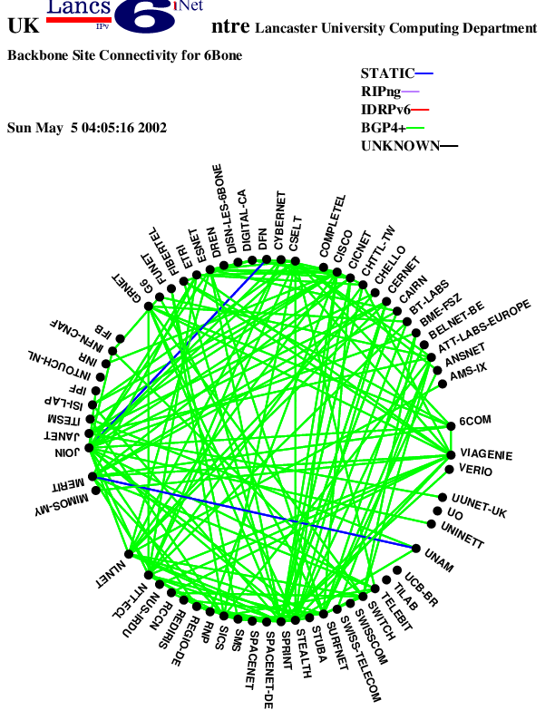
Backbone Diagram of 6bone

Slide 16
Transition to IPv6
IPv4 and IPv6 will coexist for years
Need transition mechanism to provide interoperability
Two mechanisms
  Dual IP layer
    Providing complete support for both IPv4 and IPv6 in hosts and routers
  Tunneling
    Encapsulating IPv6 packets within IPv4 headers to carry them over IPv4 routing infrastructures

Slide 17
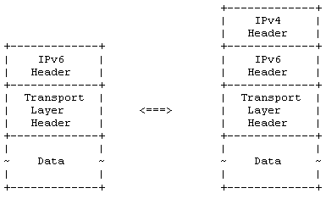
Encapsulation - Decapsulation

Slide 18
Ways of Tunneling
Router-to-router
Host-to-router
Host-to-host
Router-to-host

Slide 19
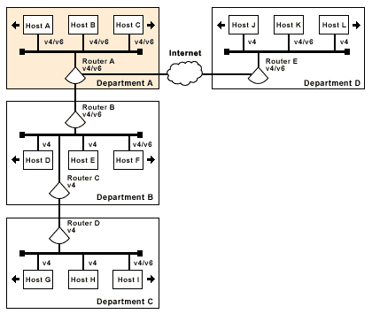
How Tunnels work?

Slide 20
Connecting to 6bone
Using
  Manually configured tunnels
  6to4 tunnels

Slide 21
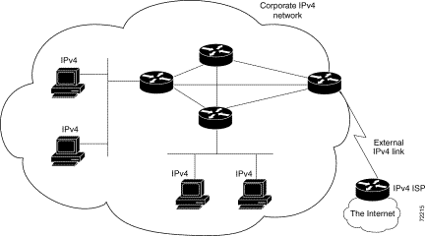
Using Manually Configured Tunnels

Slide 22
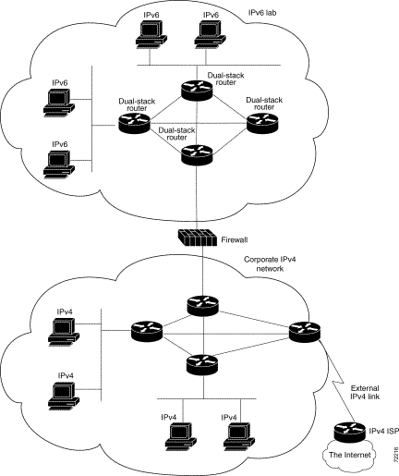
Using Manually Configured Tunnels

Slide 23
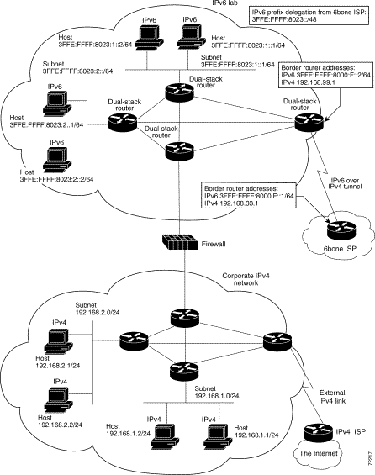
Using Manually Configured Tunnels

Slide 24
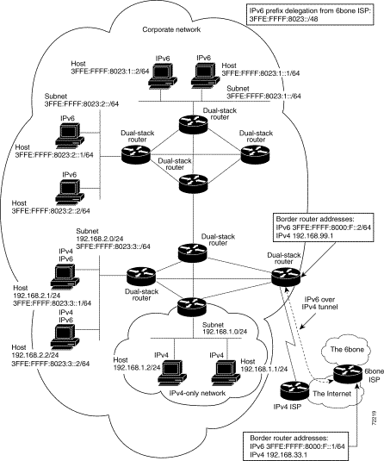
Using Manually Configured Tunnels

Slide 25
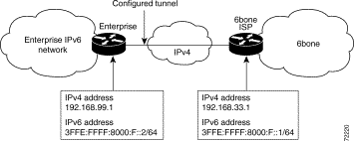
Using Manually Configured Tunnels

Slide 26
Using Manually Configured Tunnels
Advantages
  Provides a secure private connection
  Unique statistics are available
Disadvantages
  The tunnel is between two points only
  Management overhead

Slide 27
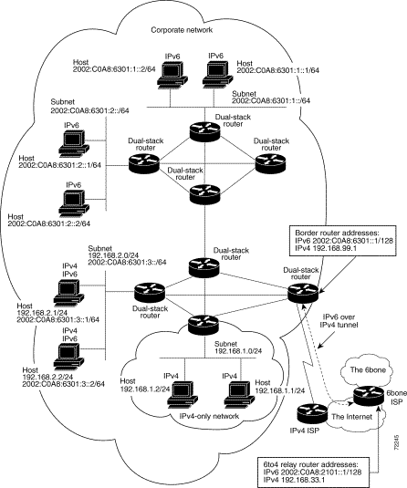
Using 6to4 Tunnels

Slide 28
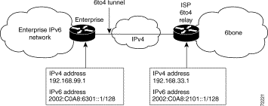
Using 6to4 Tunnels

Slide 29
Using 6to4 Tunnels
Advantages
  End user configuration simple
  Tunnel is automatic
  Tunnel exists only for the duration of the session
Disadvantages
  Cannot easily implement multihoming
  Can provide only overall traffic information
  Limited to static or BGP4+ routing

Slide 30
Implementations
Cisco supports IPv6 since IOS v. 12.2
Sun Microsystems has developed an IPv6 implementation for Solaris 8
Microsoft Windows XP and .Net Server Family Beta 3 includes IPv6
Linux starts IPv6 implementation on version 2.1.8

Slide 31
Conclusion
IPv4 address space is not enough
IPv6 solves the problems of IPv4
IPv6 will be the future Internet Protocol
But they will coexist for years
So transition mechanisms should be used

